Slide 1
System Analysis and Design

Slide 2
Required Text Book
Modern System Analysis & Design, 4th
  Jefferey A. Hoffer, Joey F. George and Joseph. S. Valacich
  Prentice-Hall, 2005
System Analysis and Design Methods, 7th
  Jeffrey L. Whitten, Lonnie D. Bentley
  McGraw – Hill, 2007

Slide 3
Course Objective
To provide you with new ways of looking at information in the world in order to solve business problems.
To introduce you to concepts and methods of SAD.
To describe the systems development life cycle (SDLC).
To teach you effective methods for gathering essential information during system analysis.
To teach you effective methods for designing systems to solve problems effectively using technology.

Slide 4
Chapter 1 - Introduction

Slide 5
Key ideas
Many failed systems were abandoned because analysts tried to build wonderful systems without understanding the organization.
The primarily goal is to create value for the organization.

Slide 6
What is a system?
A collection of parts that work together to achieve a goal/task
  Examples
    Solar system
    Public transport system
    Computer system
    Information system
A set of objects and relationships among the objects viewed as a whole and designed to achieve a purpose

Slide 7
ENVIRONMENT
INPUT
PROCESS
OUTPUT
FEEDBACK

Slide 8
Systems
Can Be Composed of Subsystems
System
Subsys A
Subsys B
Elemental
Part C
SubsysB-1
Subsys A-1
Subsys A-2
SubsysB-2
Subsys A-3
Elemental
part B1

Slide 9
What is a subsystem?
A subsystem is simply a system within a system.
  Example
    Automobile is a system composed of subsystems:
      Engine system
      Body system
      Frame system
    Each of these subsystem is composed of sub-sub --systems.
      Engine system: carburetor system, generator system, fuel system …

Slide 10
Bad system
Fail to meet requirements
Poor performance
Poor reliability
Lack of usability
Example difficulties:
  Not to schedule
  Not to budget
  Runaway = 100% over budget or schedule

Slide 11
Data and Information
Data are raw facts about the organization and its business transactions. Most data items have little meaning and use by themselves.
Data are a collection of items such as words, numbers, images, and sounds that are not organized and have little meaning individually.
Data are raw facts about people, objects, and events in an organization.
Information: Data that is organized

Slide 12
What is an Information System?
Interrelated components working together to
  Collect
  Process
  Store
  Disseminate information
to support decision making, control, analysis and visualization in an organization.

Slide 13
What is an Information System?
a system that provides the information needed to accomplish the organization’s tasks.
a computer based information system uses computers to provide the needed information.

Slide 14
Information types
Transaction Processing Systems (TPS)
Management Information Systems (MIS)
Decision Support Systems (DSS)
Expert System and Artificial Intelligence (ES &AI)

Slide 15
Transaction Processing Systems (TPS)
TPS are computerized information systems that were developed to automate the handling of data about business activities and transactions.
  Data about each transaction are captured,
  Transactions are verified and accepted/rejected,
  Validation transactions are stored for later aggregation.
  Report may be produced to provide summarization of the transactions.
  Transaction may be moved from process to process in order to handle all aspects of the business activities.

Slide 16
Management Information Systems (MIS)
Serves the functions of planning, controlling, and decision making by providing routine summary and exception reports.
Takes the relatively raw data available through a TPS and converts them into a meaningful aggregated form that managers need to conduct their responsibilities.
Developing an MIS calls for a good understanding of what kind of information managers require and how managers use information in their jobs.

Slide 17
Decision Support systems (DSS)
Combines data and sophisticated analytical models or data analysis tools to support semi-structured and unstructured decision making.
A DSS is composed of a:
  Database ( may be extracted from a TPS/MIS).
  Graphical/mathematical models for business process.
  User interface that provides a way to communicate with DSS.

Slide 18
Expert System and Artificial Intelligence (ES & AI)
Describes the way an expert would approach the problem. It attempts to codify and manipulate knowledge rather than information, (for example If .. Then rule)
User communication with an ES via an interactive dialogue.
The ES asks questions (that an expert would ask) and the end user supplies the answers.
The answers are then used to determine which rules apply and the ES provides a recommendation based on the rule.

Slide 19
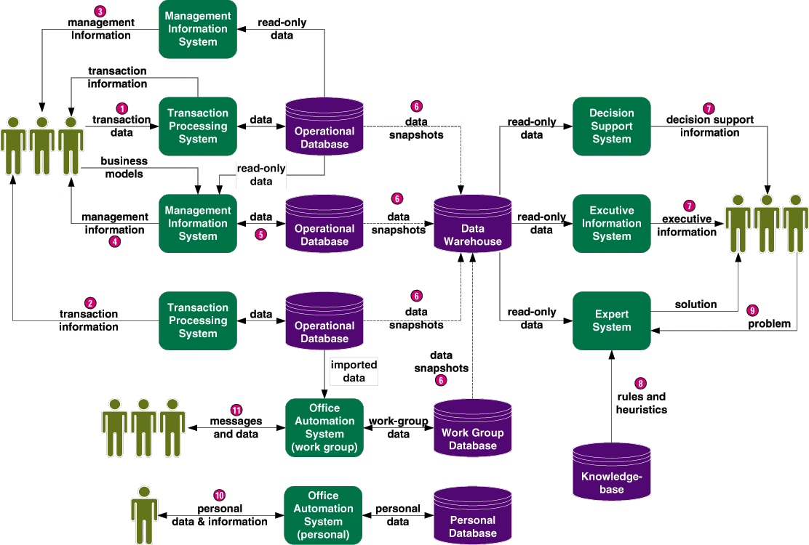
Information Systems Applications

Slide 20
Stakeholders
Persons who have an interest in an existing or new information system.
Stakeholders can be technical or nontechnical workers.

Slide 21
Stakeholders Classification
IS manger
Systems analysts in systems development
Programmers in systems development
End user in systems development
Supporting End user development
Business managers in systems development
Other IS mangers/Technicians in system development

Slide 22
Systems Analysts
The key individuals in the systems development process.
A systems analyst studies the problems and needs of an organization to determine how people, data, processes, communications, and information technology can best accomplish improvements for the business.

Slide 23
Skills of a Successful Systems Analyst
Analytical skills
  Understanding of organizations.
  Problem solving skills
  System thinking
Technical skills
  Understanding of potential and limitations of technology.
Managerial skills
  Ability to manage projects, resources, risk and change
Interpersonal skills
  Effective written and oral communication skills

Slide 24
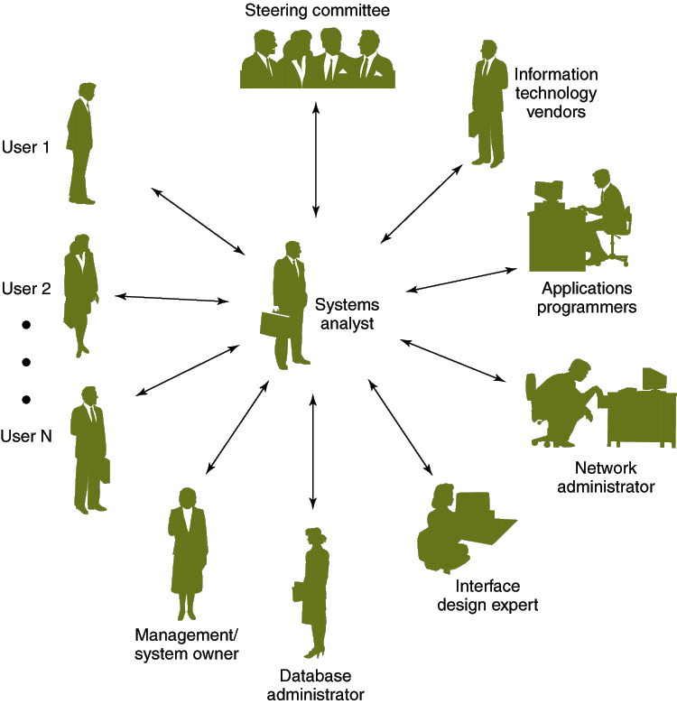
The Systems Analyst as a Facilitator

Slide 25
Skills Required by Systems Analysts
Working knowledge of information technology
Computer programming experience and expertise
General business knowledge
Problem-solving skills
Interpersonal communication skills
Interpersonal relations skills
Character and ethics
Systems analysis and design skills

Slide 26
Programmers in systems development
Programmers convert the specifications given to them by the analysts into instructions the computer can understand.
Coding: writing a computer program
Code generators have been developed to generate code from specifications, saving an organization time and money.
The aim of CASE tools (Computer-Aided Software Engineering) is to provide a variety of code generators that can automatically produce 90% or more from the system specifications normally given a programmer.

Slide 27
System Analysis and Design (SAD)
Systems Analysis: understanding and specifying in detail what an information system should do.
System Design: specifying in detail how the parts of an information system should be implemented.
Analysis: defining the problem
  From requirements to specification
Design: solving the problem
  From specification to implementation

Slide 28
Systems Development Life Cycle (SDLC)
SDLC phases
  1-Project identification and selection
  2-Project initiation and planning
  3-Analysis
  4-Design
    4.1Logical design
    4.2Physical design
  5-Implementation
  6-Maintenance

Slide 29
Project identifying and selection
This stage is critical to the success of the rest of the project.
People
  Users, analyst, system managers coordinating the project.
Activities
  Interviewing user management, summarizing the knowledge obtained estimating the scope of the project and documenting the result.
Output
  Feasibility report: problem definition and summarizing the objectives.

Slide 30
Project initiation and planning phase
A detailed plan is developed for conducting the remaining phases of the SDLC for the propose system.
  Detailed step – work plan - high level system requirement –assignment of team members.

Slide 31
Analysis phase
Description of current system.
Where problem and opportunities are with a general recommendation on how to fix, enhance or replace current system.
There are six primary activities in this phase
  Gather information.
  Define system requirements.
  Build prototypes for discovery of requirements .
  Prioritize requirements.
  Generate and evaluate alternatives.
  Review recommendations with management.

Slide 32
Design phase
The description of the recommended solution is converted into logical and then physical system specification.
Logical design
  The part of the design phase of the SDLC in which all functional feature of the system chosen for development in analysis are described independently of any computer platform.
Physical design
  The part of the design phase of the SDLC in which the logical specification of the system from logical design are transformed into technology specific details from which all programming and system construction can be accomplished.

Slide 33
Design phase
Seven major activities must be done during design
  Design and integrate the network.
  Design the application architecture.
  Design the user interfaces.
  Design the system interfaces.
  Design and integrate the databases.
  Prototype for design details.
  Design and integrate the system controls.

Slide 34
Implementation
The fifth phase of the SDLC in which the information system is
  Coded,
  Tested,
  Installed, and
  Supported in the organization.
Outputs
  Code, documentation, training procedures and support capabilities.

Slide 35
Maintances
The final phase of the SDLC in which the information system is systematically repaired and improved.
New versions of releases of software with associated updates to documentation, training, and support.

Slide 36
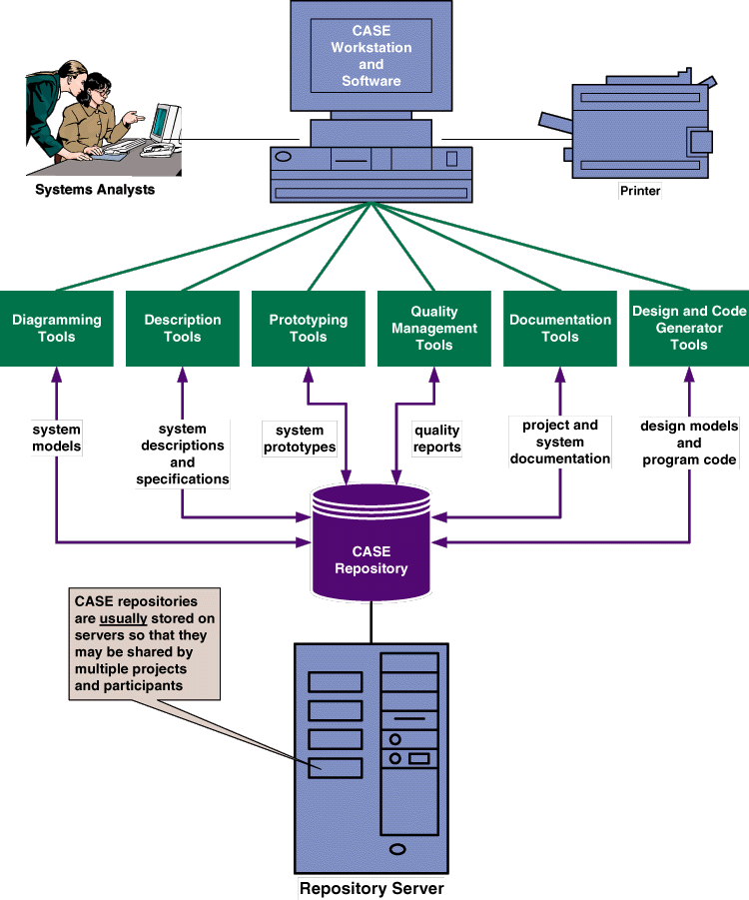
Computer-Aided Systems Engineering (CASE tools)
Software programs automate or support the drawing and analysis of system models and provide for the translation of system models into application programs.

